Slide 1

Chapter No. 9 The Assessment Function with Opportunities

Slide 2
Pitfalls in selecting new ventures
Lack of objective evaluation.
No real insight.
Inadequate understanding of technical requirements
Poor financial understanding.
Lack of venture uniqueness.
Ignorance of legal issues.

Slide 3
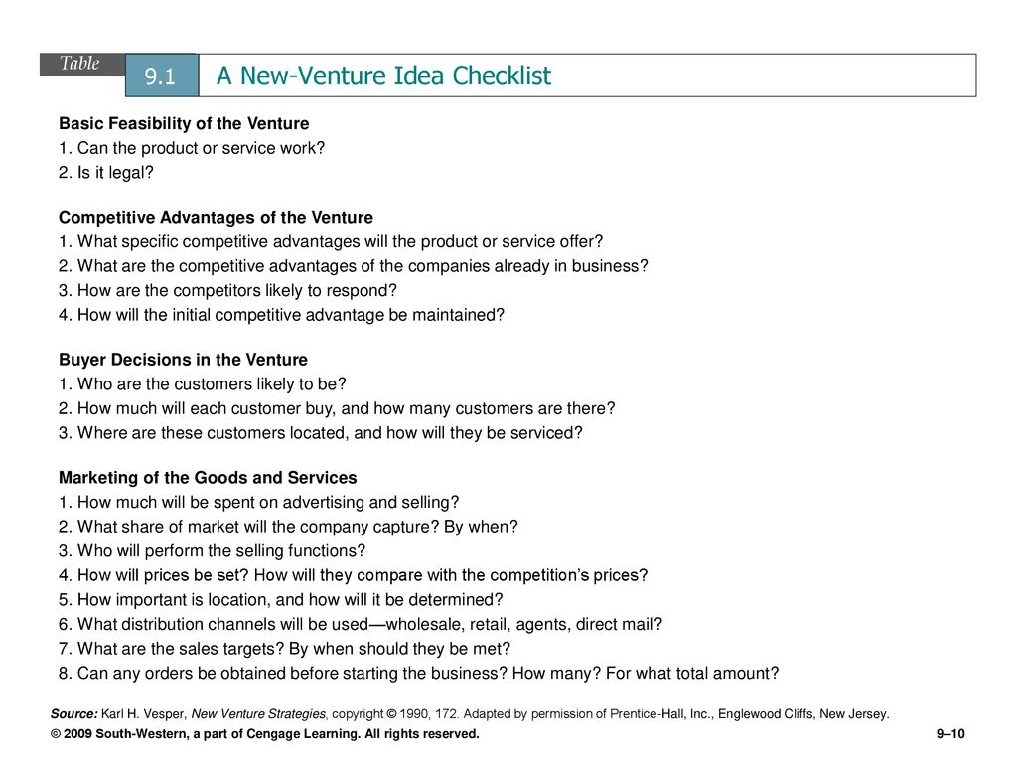
Answer the following (part of the project)

Slide 4
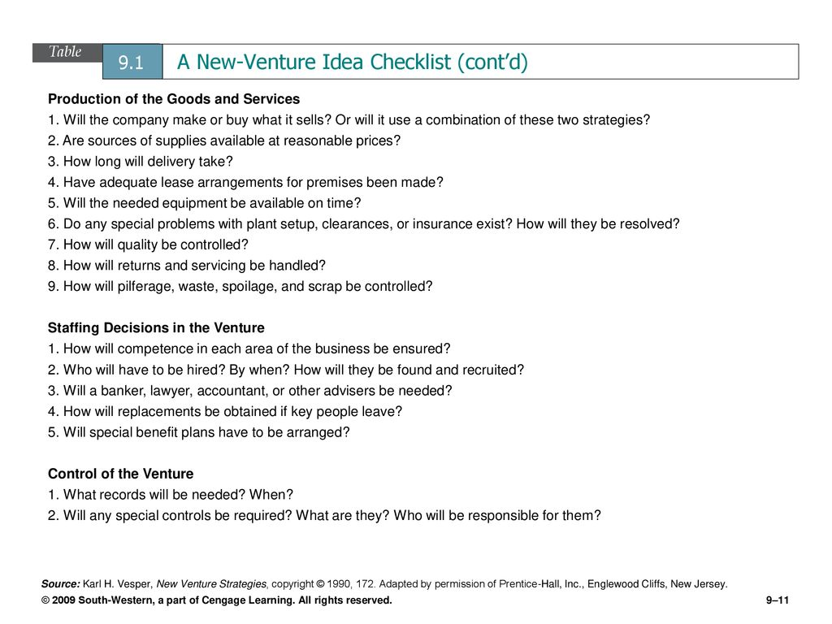

Slide 5
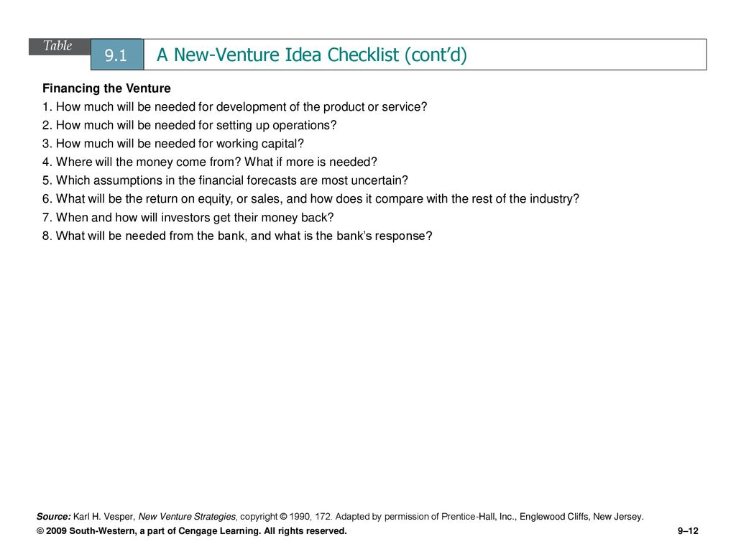

Slide 6
Critical factors for new venture development
Uniqueness.
Investment.
Growth of sales.
Product availability.
Customer availability.

Slide 7
Why new ventures fail?
Poor timing (Recent Window of Opportunity – success story )
Product design problems.
Inappropriate distribution strategy.
Unclear business definition (direct / indirect / commission etc)
Overreliance on one customer.
The financial difficulties
Initial undercapitalization.
Assuming debt too early.
Venture capital relationship problems
Managerial problems
Concept of team approach.
Human resource problems.

Slide 8
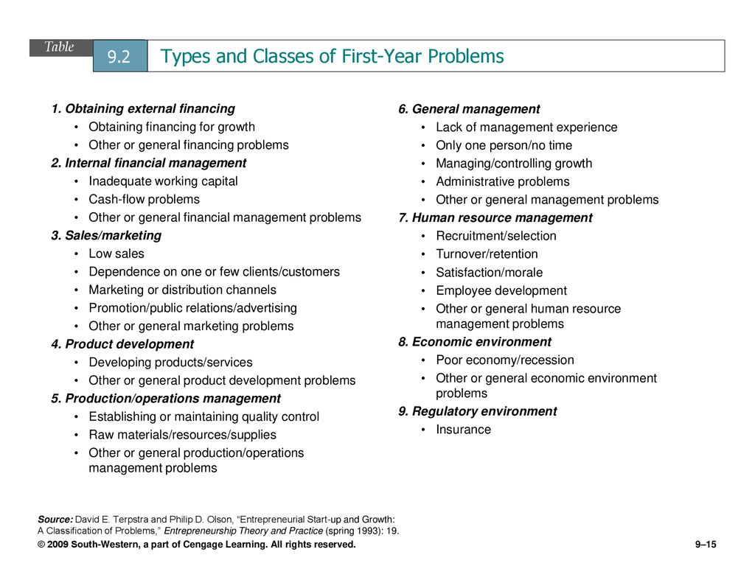
What are you anticipating? (part of the project)

Slide 9
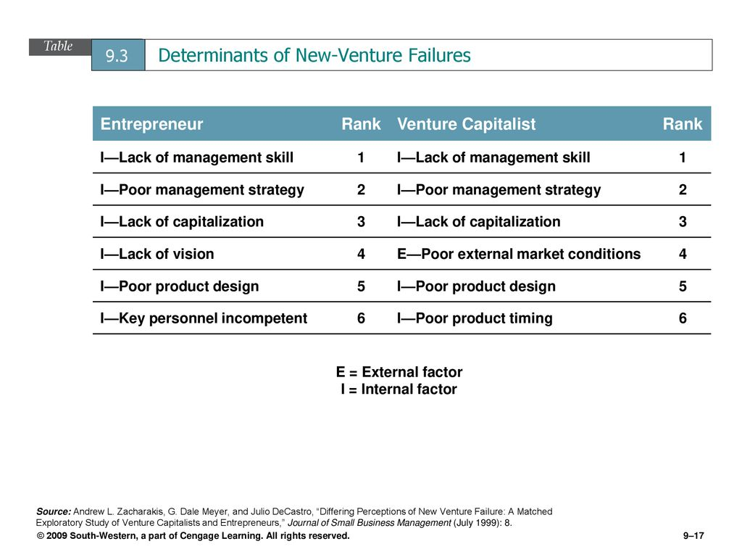

Slide 10


Slide 11
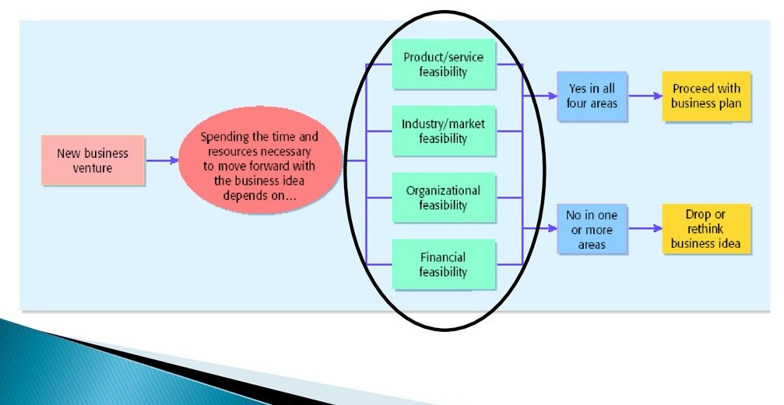

Slide 12
Feasibility Criteria Approach
Is it proprietary?
Are the initial production costs realistic?
Are the initial marketing costs realistic?
Does the product have potential for very high margins?
Is the time required to get to market and to reach the break even point realistic
Is the potential market large?
Is the product the first of a growing family? (attractive to investors).
Does an initial customer exist?
Is this a growing industry?
Can the product – and the need for it – be understood by the financial community?

Slide 13
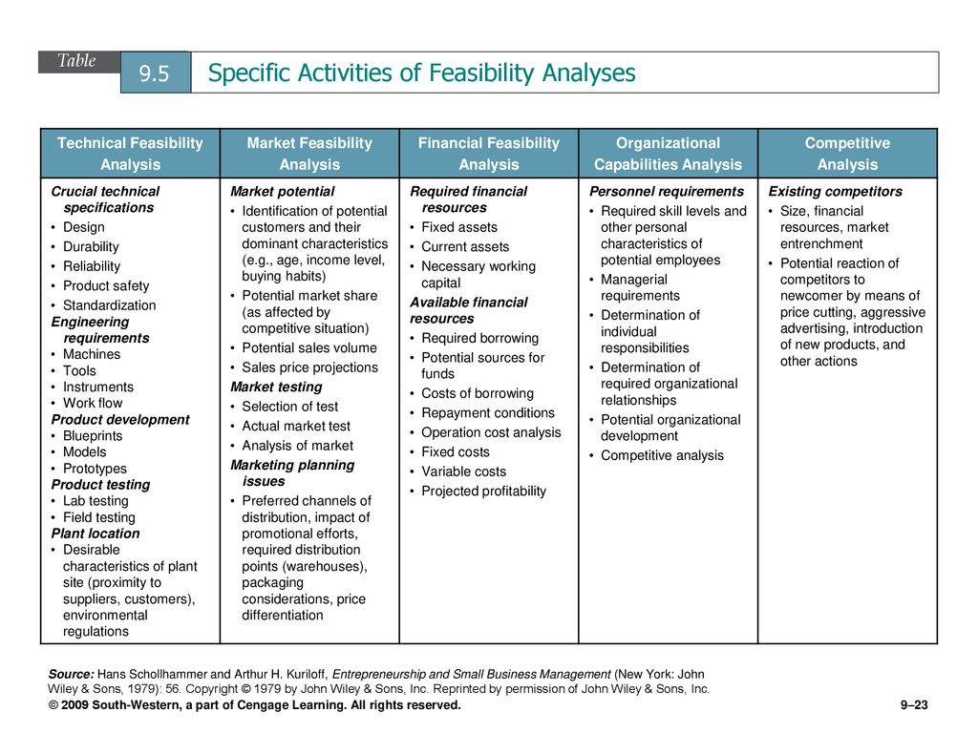
Up to the team to choose few or all from this table part of the project

Slide 14
Quiz (chapter 9)Section A (17th May 2023)
Why “LACK of VENTURE UNIQUENESS” is a red flag for an investor when you are giving presentation in front of an investor for the capital?
Why “OVER RELIANCE ON ONE CUSTOMER” is a red flag for an investor when you are giving presentation in front of an investor for the capital?
Why “ORGANIZATIONAL FEASBILITY” is very important for an entrepreneur to avoid red flags at the time of giving presentation in front of an investor for the capital?
“POOR TIMING” is one of many reasons of venture failure, what do we mean by that?
To avoid “POOR TIMING”, one way is to follow the concept of “WINDOW OF OPPORTUNITY”? When and Why?

Slide 15


